Slide 1
Decision Tree Learning

Slide 2
Decision tree Model
Decision Tree is a tree like predictive model used for regression and classification.
It is a supervised learning model

Slide 3
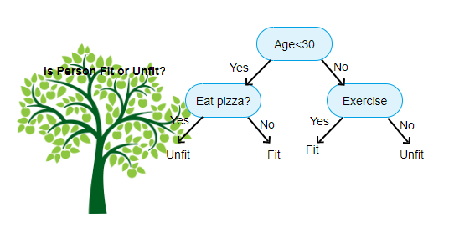

Slide 4
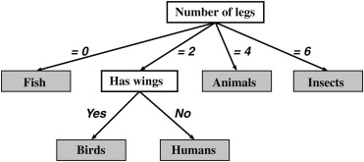
Divide and conquer
Decision trees are built using recursive partitioning. This approach is generally known as divide and conquer because it uses the feature values to split the data into smaller and smaller subsets of similar classes.

Slide 5
Beginning at the root node, which represents the entire dataset, the algorithm chooses a feature that is the most predictive of the target class.
The examples are then partitioned into groups of distinct values of this feature; this decision forms the first set of tree branches.
The algorithm continues to divide-and-conquer the nodes , choosing the best candidate feature each time until a stopping criterion is reached. This might occur at a node if:
All (or nearly all) of the examples at the node have the same class
There are no remaining features to distinguish among examples
The tree has grown to a predefined size limit

Slide 6
Choosing the best split
At each level of decision tree construction an attribute in the dataset consider as a splitting attribute.
Splitting is performed based on the value of this attribute.
While constructing the decision tree main challenge is to find out this splitting attribute.
Random selection is not a good idea, it may give bad results with low accuracy.
Best splitting attribute is determine using information gain.

Slide 7
Entropy & Information gain
Entropy is the measure of impurity in a data set.
In a subset, if all the samples are in the same class, then it is called pure.
Decision tree uses entropy to quantifies the randomness within a set of data.
Decision tree hopes to find splits that reduce entropy, ultimately increasing homogeneity within the groups.
If there are only two possible classes entropy values can range from 0 to 1
For n classes entropy ranges from 0 to log₂(n).
Minimum value indicate that the sample is completely homogeneous.

Slide 8
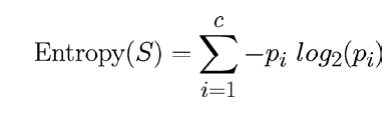
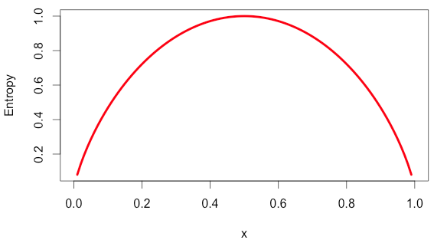
Entropy can be calculated as:
C-number of class levels
Pi-Proportion of values falling into class level I
S-subset of a dataset
X-Proportion of samples

Slide 9
As illustrated by the peak in entropy at x = 0.50 , a 50-50 split results in the maximum entropy.
Information gain is the measure of change in homogeneity or it is a measure of reduction in entropy.
The information gain for a feature F is calculated as the difference between the entropy in the segment before the split (S 1 ), and the partitions resulting from the split (S 2 ):
InfoGain ( F ) = Entropy ( S 1 ) − Entropy ( S 2 )
The higher the information gain the better a feature is at creating homogeneous group.

Slide 10
Information gain using entropy calculation-Example
Consider an example where we are building a decision tree to predict whether a loan given to a person would result in a write-off or not.
Our entire population consists of 30 instances. 16 belong to the write-off class and the other 14 belong to the non-write-off class. We have two features, namely “Balance” that can take on two values -> “< 50K” or “>50K” and “Residence” that can take on three values -> “OWN”, “RENT” or “OTHER”.

Slide 11
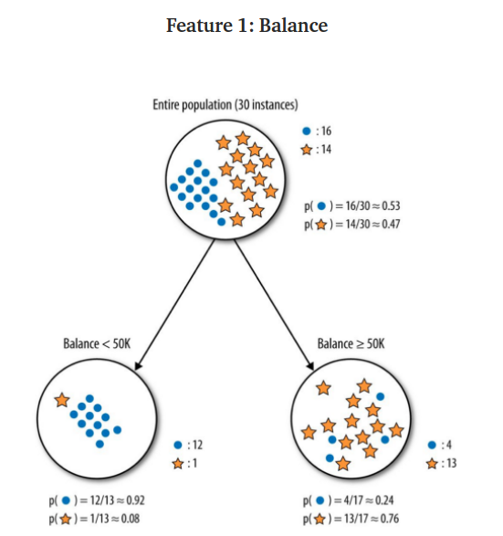

Slide 12
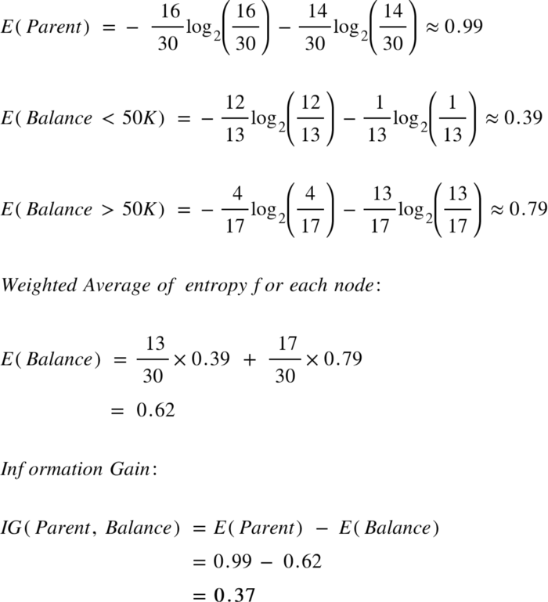

Slide 13
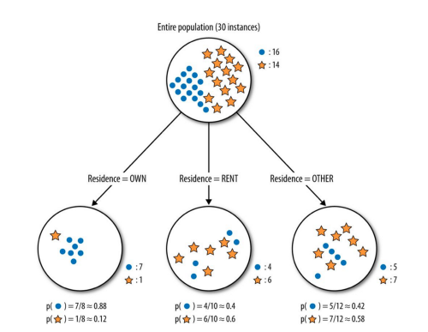
Feature 2-Type of residence

Slide 14
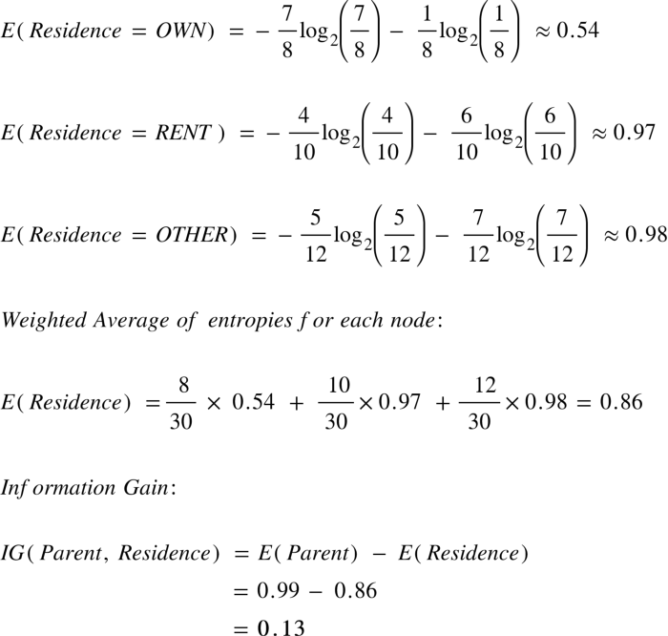

Slide 15
C5.0 -steps
A C5.0 model works by splitting the sample based on the field that provides the maximum information gain.
Each sub-sample defined by the first split is then split again, usually based on a different field, and the process repeats until the subsamples cannot be split any further.
Finally, the lowest-level splits are re-examined, and those that do not contribute significantly to the value of the model are removed or pruned.

Slide 16
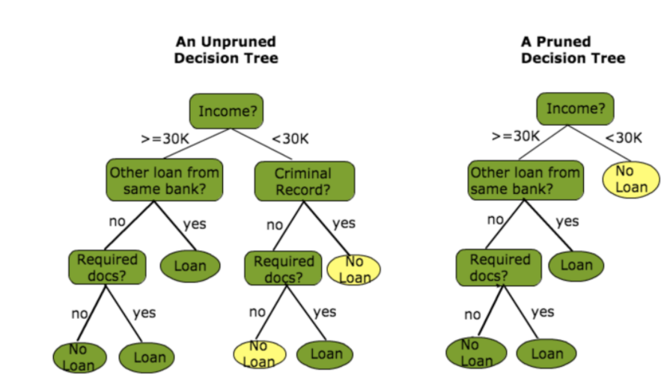
Pruning the decision tree
The main problem in decision tree is that ,if it has too many branches can result in overfitting of the training data.
Pruning a decision tree helps to prevent overfitting the training data so that model generalize well to unseen data.
Two types of pruning
-pre-pruning
-post pruning

Slide 17
Pre-pruning
Subtree construction is halted at a particular node after evaluation of some measures like information gain.
Pruning condition set based on some measures.
If the condition is satisfied prune the subtree ie replace the decision node with a leaf node.
Post pruning
Prune after the tree built.
Built the tree entirely using decision tree algorithm, then prune the subtree in the tree in a bottom up fashion.

